Slide 1
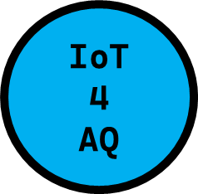


AIR QUALITY AND IoT-BASED AIR SENSORS – PART 2: MICROPROCESSORS
DEMO N° 3
ESP32/Wi-Fi module/PMS5003
Uli Raich

Slide 2
Here is the agenda…
The Internet of Things
First processors
Arduino (AVR)
ESP32
Linux based processors

Slide 3
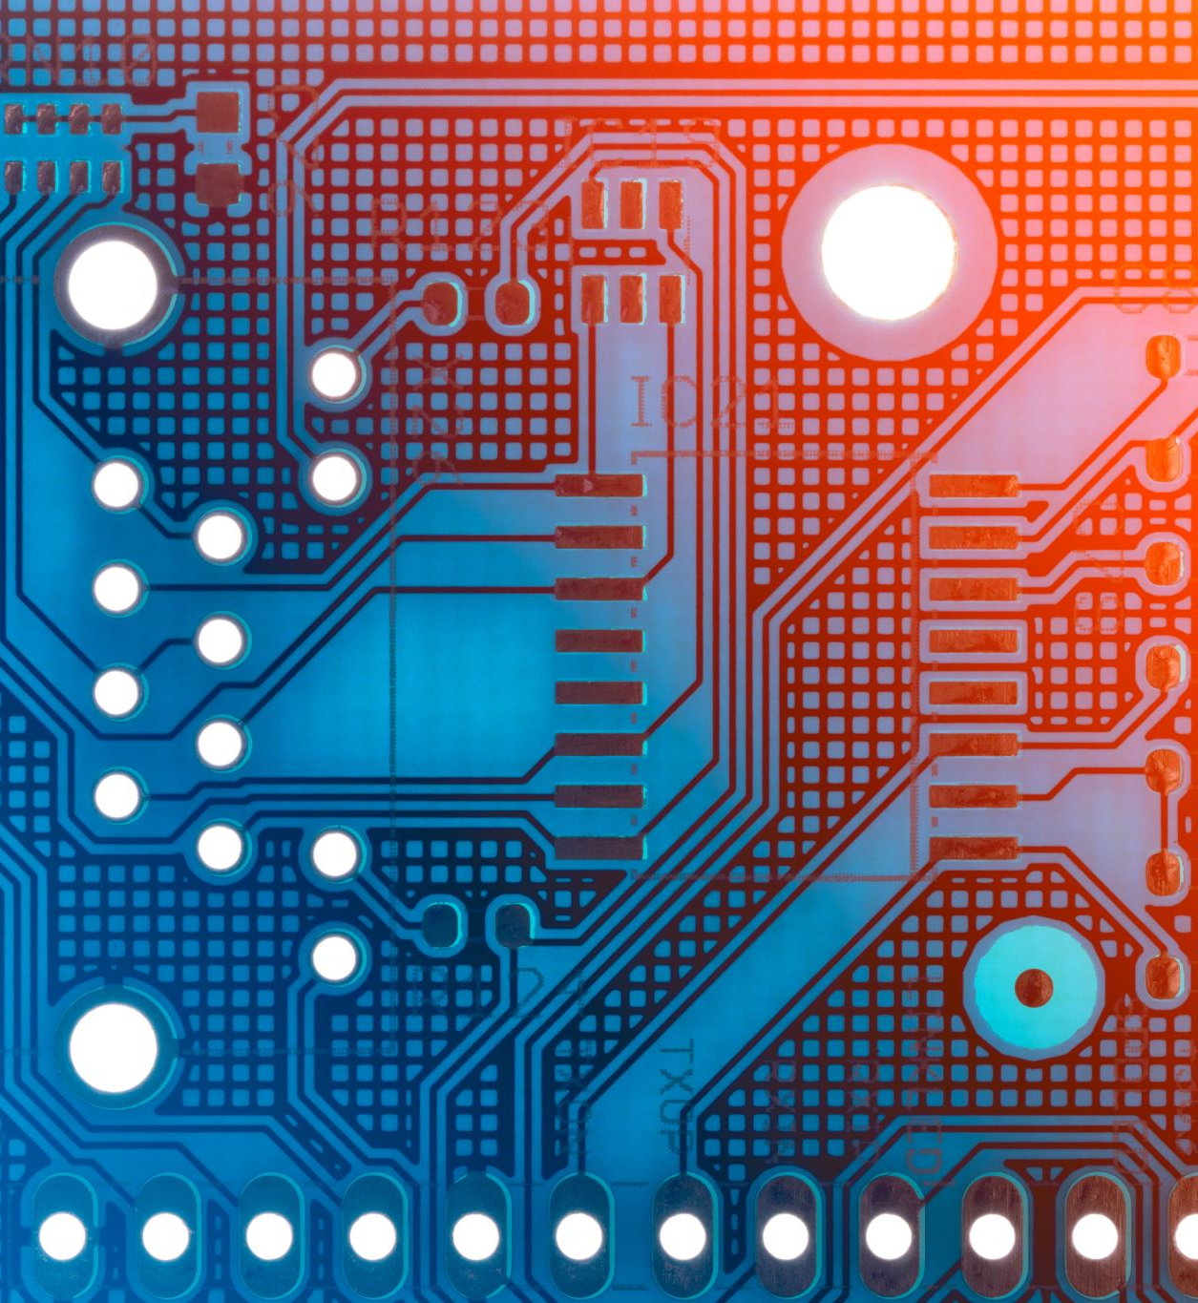
1. The Internet of Things

Slide 4
What is IoT?
Wikipedia:
The Internet of Things (IoT) describes physical objects (or groups of such objects) with sensors, processing ability, software and other technologies that connect and exchange data with other devices and systems over the internet or any other communication networks

Slide 5
IoT
The name “Internet of Things” already suggests that there are two distinct components to it:
Things, which are represented by sensors and actuators. We therefore must have a means to read out these sensors and to control the actuators. Hardware interfaces are needed for this.
Internet, we must be able to send data read from the sensors to the Internet and receive commands for the actuators from it. This means that we need a network interwork and the software to run the network protocols.

Slide 6
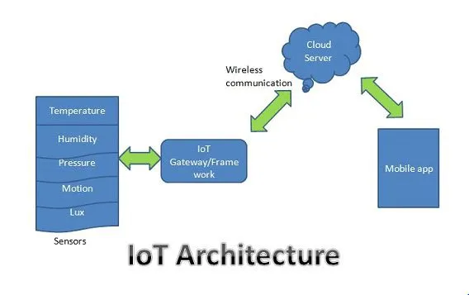
IoT system architecture

Slide 7
1. IoT systems
PM sensors
LCD
Battery
P, T, RH sensors
µCPU
Comm
CO₂ sensor
Data
Store
VOC sensors
GPS
VOC sensors

Slide 8
1. IoT Network technologies
Low Power Wide Area Network (LPWAN) - LoRa (Long Range), Haystack, SigFox, NB-IoT(Narrow-Band IoT)… long-range wireless
Bluetooth 2.4 GHz wireless communication protocol (< 100 m)
ZigBee (2.4GHz wireless communication spectrum, <100 m)
Near field communication (NFC) protocol – (very small range < 4 cm),
Radio Frequency Identification (RFID) - store identifiers and data.
Wifi - wireless network (IEEE 802.11a/b/g/n specifications)
Cellular networks (2G, 4G, 5G)
Etnernet - wired connectivity within LAN (IEEE 802.3 standard).

Slide 9
What is an IoT system composed of?
We need:
Sensors and actuators
A processor, powerful enough to run the network protocol layers
A network interface: either Ethernet of WiFi
Interfaces to the sensors and actuators:
General Purpose I/O (GPIO) lines
I2C, I2S, SPI, serial interfaces
The cost for the controller should be in a good relation with the cost of the things

Slide 10
2. FIRST PROCESSORS

Slide 11
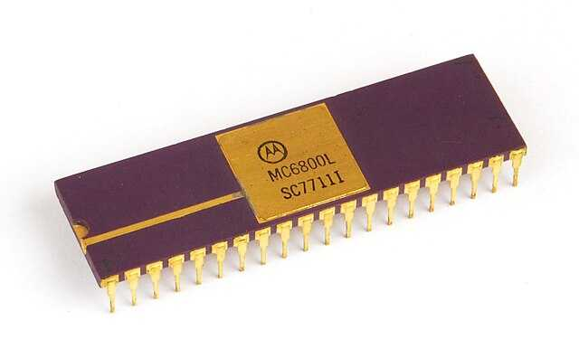
The M6800 Microprocessor
Up to the 1970’s computers filled racks or even rooms.
Then the micro-processor came onto the market integrating a CPU (Central Processing Unit) onto a single silicon chip.
These devices had no on-chip memory nor on-chip interfaces. A bus system allowed to connect peripherals.

Slide 12
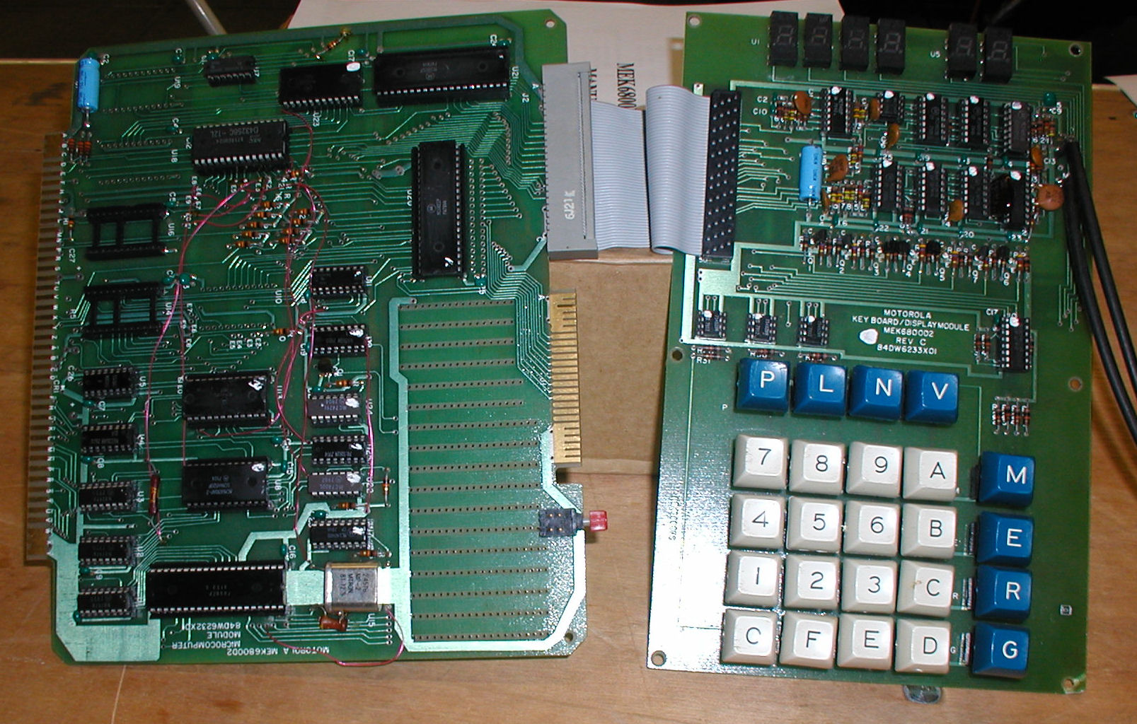
Early Microprocessors systems
This is how a micro-processor system looked like in the end 1970’s:
1 MHz clock
~ 2 kB of ROM (EPROM) memory
128 bytes of RAM
Keyboard to enter hex instruction code
Audio tape to save programs

Slide 13
3. Arduino (AVR)

Slide 14
Today’s micro-controllers
There are modern micro-controllers which still use 8-bit memory busses like the AVR168 used on the Arduino Uno.
There are two types of memory devices:
RAM: Random access memory
ROM: Read Only memory
In the old times we used EPROMS (Erasable Programmable Read only Memories), which were programmed with a high programming voltage and erased with ultra-violet light.
Today flash memories are used, which are electrically programmable.

Slide 15
The AVR168
The Atmel AVR168, used in the Arduino Uno (see later) is a:
AVR RISC (Reduced Instruction Set Computer) based CMOS 8-bit micro-controller with
16 KB flash memory
512B EEPROM (Electrically Erasable PROM)
1KB SRAM (Static RAM)
20 MHz typical clock speed
It has a series of interfaces: GPIO (General Purpose Input Output) lines, UART (Universal Asynchronous Receiver Transmitter) for serial communication, Two.Wire serial interface, SPI (Serial Peripheral Interface) serial port, ADC (Analog to Digital Converter).
These additional interfaces make it a micro-controller in contrast to a micro-processor, which has the CPU only.

Slide 16
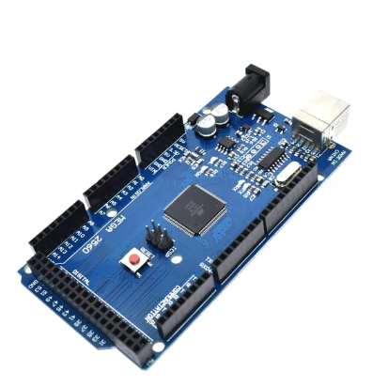
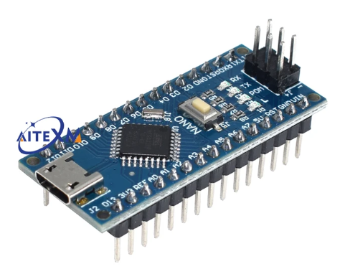
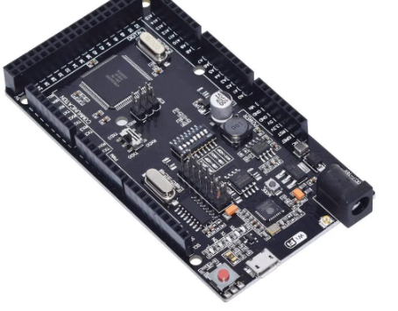
Arduino boards
Arduino Nano
Smaller footprint
Arduino Mega
Uses Atmega2560 processor
Atmega with WiFi interface

Slide 17
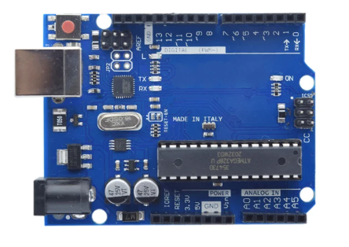
The Arduino Uno
The Arduino SDK was developed for the Arduino board (e.g. Arduino Uno) featuring the Atmel
ATMeg328P processor
32kB Flash memory
2kB SRAM
1kB EEPROM
a number of interfaces
GPIO, SPI, I2C, ADC
and a standardized connector for piggyback “shields”

Slide 18
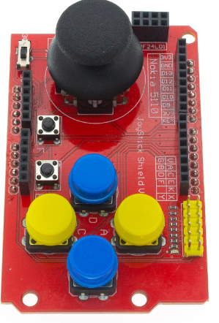
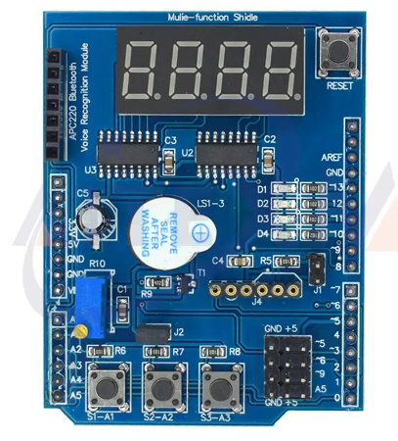
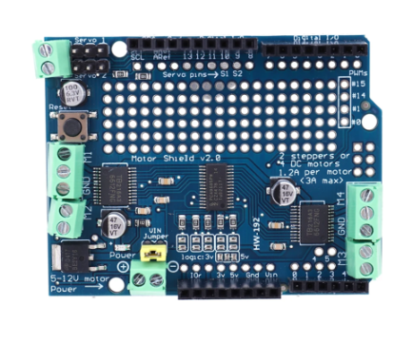
Arduino Shields
Motor controller shield
Joypad shield
Multifunction shield

Slide 19
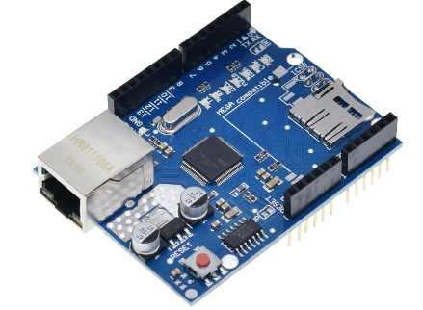
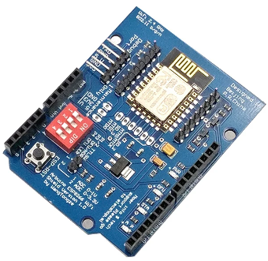
Network Shields
Ethernet shield
Wifi shield

Slide 20
4. The ESP32

Slide 21
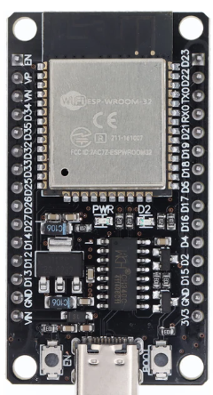
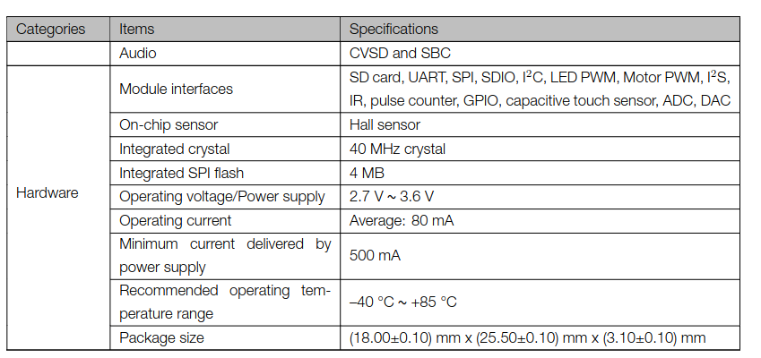
ESP32 features

Slide 22
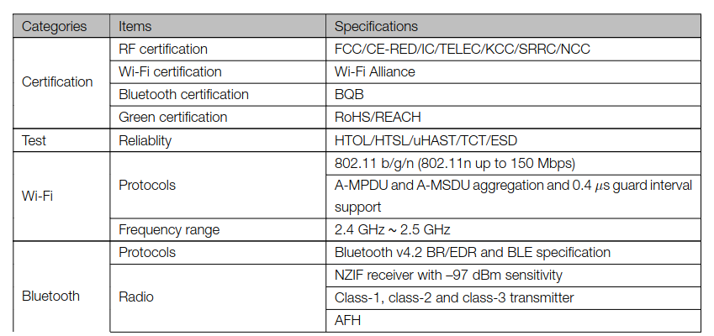
ESP32 Network Interfaces
ESP

Slide 23
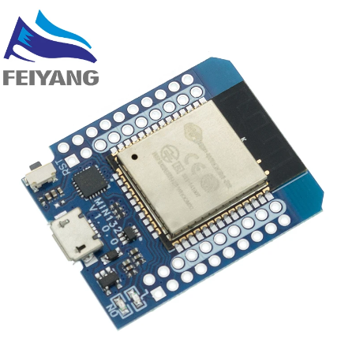
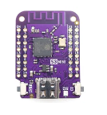
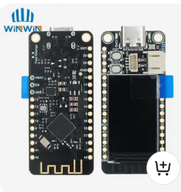
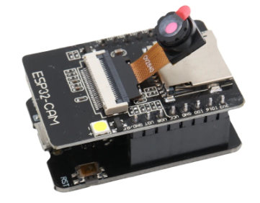
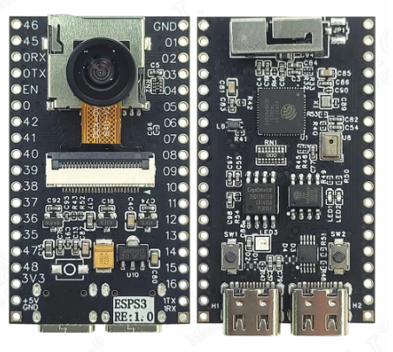
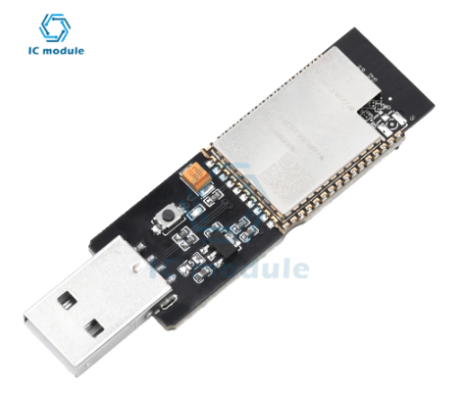
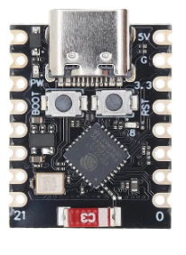
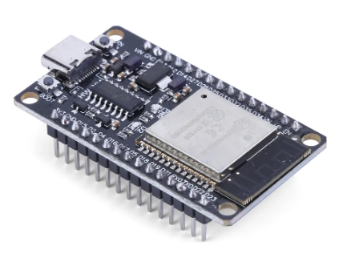
A variety of ESP32 CPU boards
ESP32S3 WeMos
ESP32 WeMos
ESP32 with LCD
ESP32-CAM
ESP32C3 RiscV
ESP32 S3 with camera
and microphone
ESP32 USB
ESP32-DevKit

Slide 24
ESP32 interfaces
The ESP32 has a big number of interfaces implemented on the chip:
GPIO pins
PWM
Capacitive touch sensor
I2C (Inter Integrated Circuit) interface
SPI (Serial Peripheral Interface) interface
Analogue to digital converter
Digital to analogue converter
Timer

Slide 25
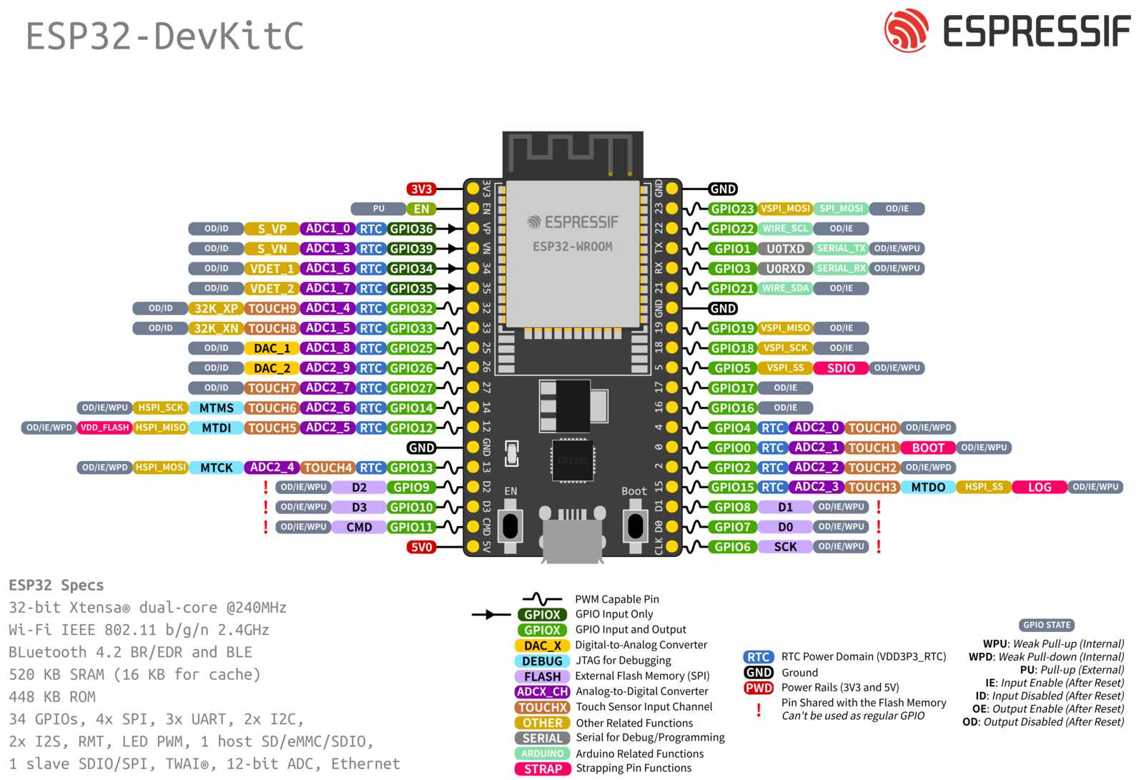
ESP32 DevKit pin out

Slide 26
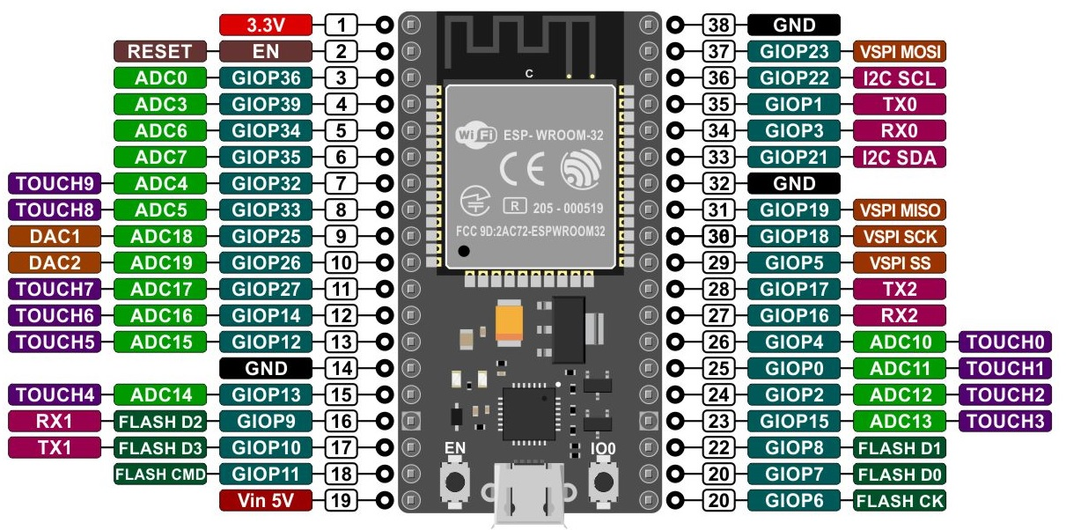
ESP32 DevKit pin out

Slide 27
5. Processors capable of running Linux

Slide 28
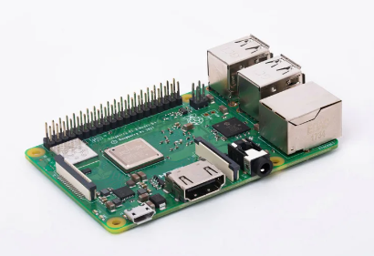
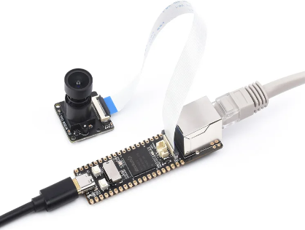
Micro-controllers running Linux
Raspberry Pi 4 or 5
Luckfox Pico Pro Max

Slide 29
The Luckfox Pico
Just like the Raspberry Pi, the Luckfox Pico can run Linux off an SD card and it has an Ethernet interface.
However, a screen and keyboard and mouse cannot be connected to it.
You can however connect to the Luckfox over the network using ssh and use the X11-forwarding to get the graphical user interface of your applications on the screen of your PC or MAC.
The Luckfox also has a camera interface and it features a processor for AI applications. It is therefore particularly suited for image treatment.
At a price of ~ 20 US$ it is still rather cheap.

Slide 30
Micro-controller speed
The speed at which a micro-controller can executed your programs depends of its clock speed, its instruction set, memory access speed and the width of its memory bus.
As an example:
The ESP32 uses a dual core (2 CPUs on the chip) Xtensa 32-bit LX micro-processor running at 240 MHz
You can imagine that it will run faster than the AVR168, which has only 8 bits and runs at 20 MHz clock speed.
The Raspberry Pi, as a top end processor, has a Broadcom BCM2711, Quad Core Cortex-A72 (ARM v8) 64-bit processor, running at 1.8 GHz.
You can imagine that the price of the processor depends on its performance.

Slide 31
Choosing a micro-controller
Question of
Needs (how much memory, which speed, which interfaces …)
Network interface?
Budget
Software environment and programming language
Previous experience
Taste
Because of its computing power, its interfaces, its network connectivity and its low price we selected the ESP32. It is fully sufficient for the type of system we want to build.

Slide 32
If you find any difficulty, at any step, please feel free to contact us! Dr. J. Taamté (mtjfirst@yahoo.fr) Dr. U. Raich (uli.raich@gmail.com) Dr. B. Tchanche (bertrand.tchanche@uadb.edu.sn)

